Slide 1
FEEDBACK:
Sensitivity / specificity as a metric (over-, undersegm.)
No simpler method
Take more training samples on less training images
Add one slide on clinical problem
More numbers for images in presentation (stats etc.)
Reasoning / interpretation very good
Plot feature importance (numbers / bars)
More insight in the situation (training-, testing-setup)
Compare testing-time
Segmentation of brain tissues
Final Presentation MIALab
Matthias Fontanellaz, Michel Hayoz, Jonas Ledergerber
19.12.2018, ISTB Uni Bern
Notes:
1

Slide 2
Content
Clinical Problem
Goals
Setup
Methods
Results / Discussion
Conclusion
Outlook
19.12.2018
Segmentation of brain tissues
2
Notes:
2

Slide 3
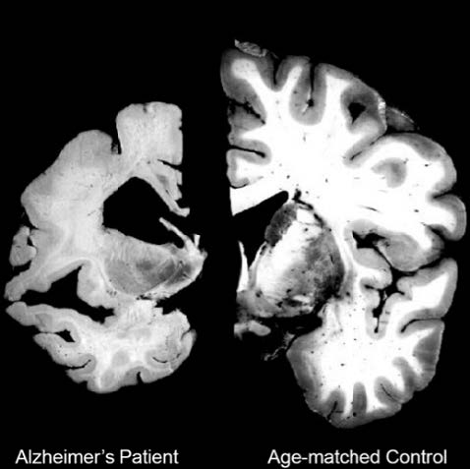
Clinical Problem
Neurodegenerative diseases: Alzheimer, Parkinson, …
High clinical need
Numbers to increase
Degree and progression of the disease (Alzheimer)
Atrophy of the brain
Segmentation of brain tissues in MRI images
Manual segmentation not viable
Machine Learning approach
19.12.2018
Segmentation of brain tissues
3
Notes:
3

Slide 4
Goals
Understand differences and advantages of different machine learning approaches on segmenting brain tissues.
Interpret individual feature importance and their influence on segmentation quality.
19.12.2018
Segmentation of brain tissues
4
Notes:
4

Slide 5
Setup
Data
100 unrelated healthy subjects – Human Connectome Project preprocessed data set (skull stripped, bias field corrected, registered..)
Pipeline – Supervised Machine Learning
Training on training data (70 ground truth images)
Testing on testing data (30 unseen images)
Usually testing on less images
19.12.2018
Segmentation of brain tissues
5
Notes:
5

Slide 6
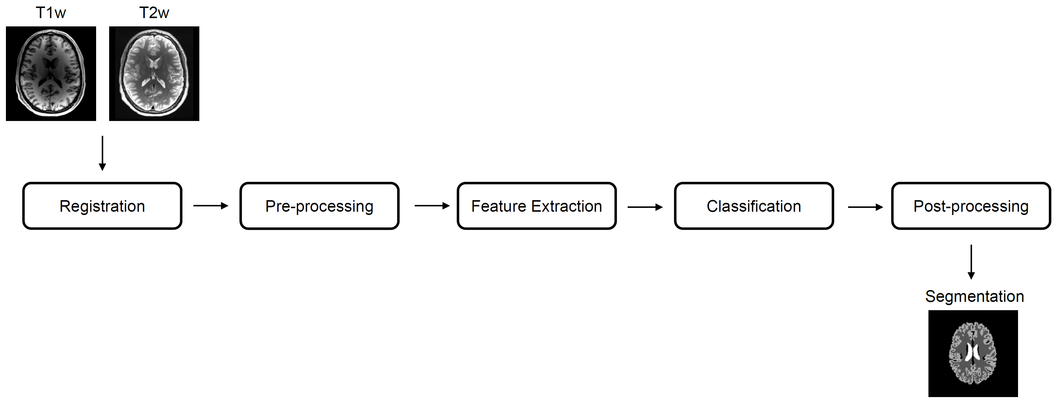

Slide 7
Methods
Evaluate different methods for segmentation
Random forest
Logistic regression
SVM linear
SVM linear polynomial features
SVM rbf
Approach
Balance training samples per class
Adjust training samples with respect to training images
19.12.2018
Segmentation of brain tissues
7
Notes:
Logistic regression, SVM linear, SVM rbf (radial basis function kernel): compare how they do with respect to the existing random forest in the pipeline (what’s the potential if we finetune the methods and what parameters and changes lead to what outcome?)
Importances of features for the different methods and gaining an understanding how changes effect the segmentation.
Approaches:
7 original features + polynomial features (position -> x^2, xy, xz, yz, y^2, z^2) mapping the input into high-dimensional feature spaces to perform non-linear classification
Parameter tuning (GridSearch for C where applicable)
Balance of training examples per class (smaller structures are relatively more taken into account)
Feature scaling
7

Slide 8
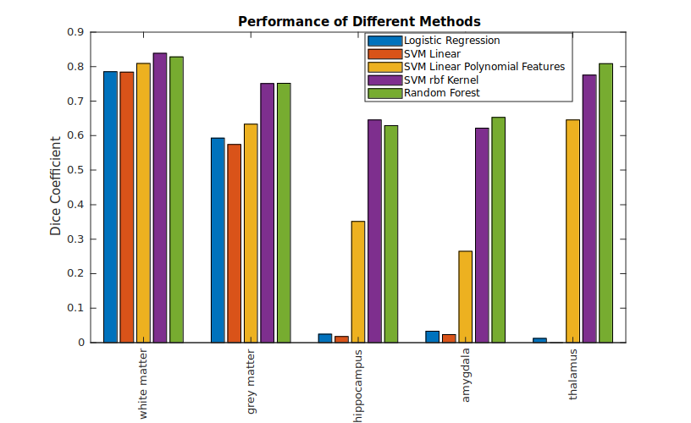
Results / Discussion
19.12.2018
Segmentation of brain tissues
8

Slide 9
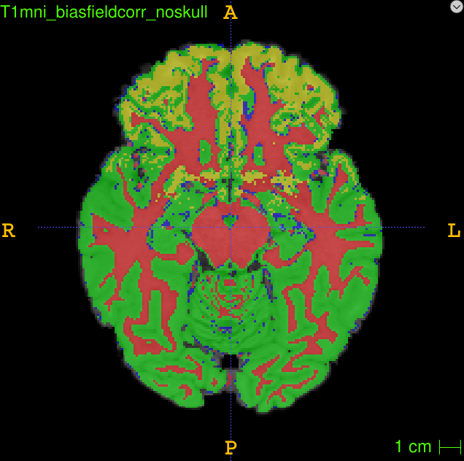
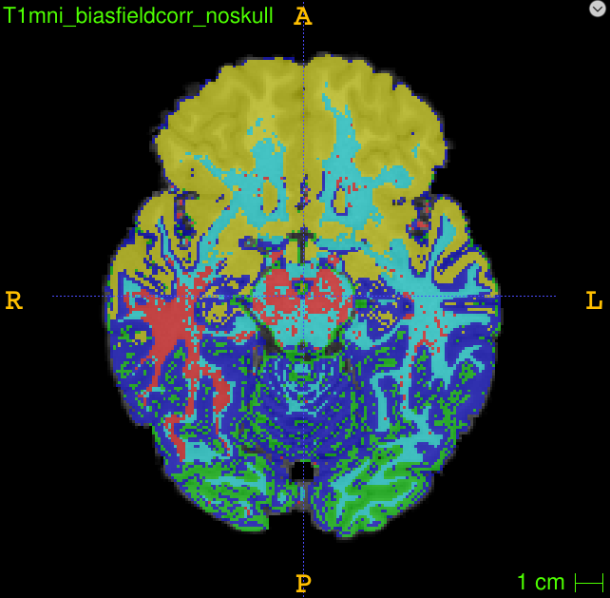
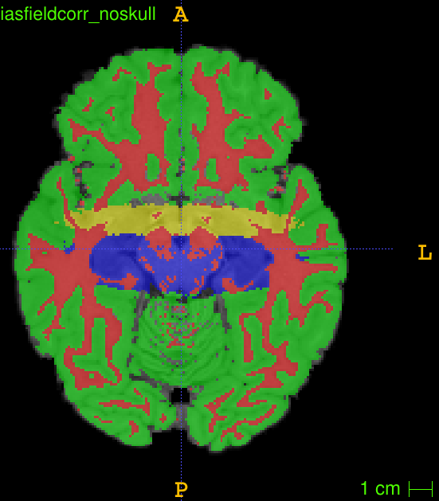
Insights SVM (linear)
Same features as RF
→ intensity feature
Balanced samples
→ intensity feature
→ small structures important
Second order coordinates
→ position feature important
→ complex boundaries require high order terms
19.12.2018
Segmentation of brain tissues
9

Slide 10
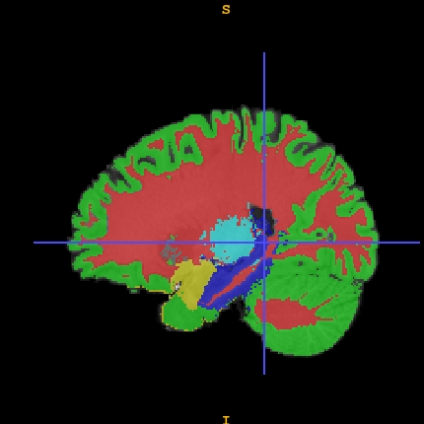
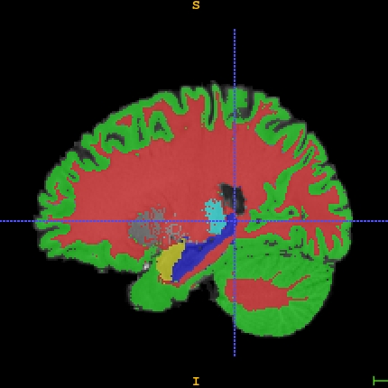
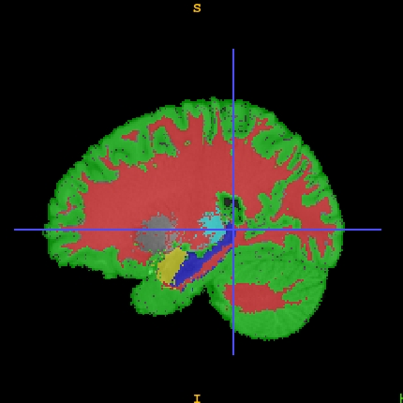
Insights SVM (rbf)
C=5, G=0.3
Oversegmentation of small structures
Random Forest
Reference
C=15, G=10
Undersegmentation of small structures
19.12.2018
Segmentation of brain tissues
10

Slide 11
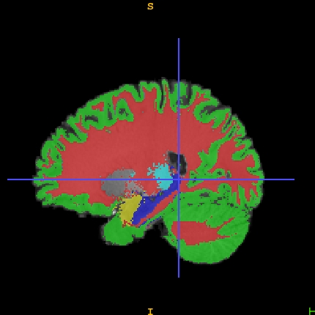
Insights SVM (rbf)
Random Forest
Reference
C=15, G=5
19.12.2018
Segmentation of brain tissues
11

Slide 12
Conclusion
Dice is not sufficient as a standalone metric
Overall segmentation quality is best with an SVM rbf kernel. Comparable to random forest tree results.
Large structures are more easy to segment
Linear kernels struggle more with small structures
In a case where the ground truth images do not have big variance, less ground truth images can be used for training with similar segmentation outputs.
19.12.2018
Segmentation of brain tissues
12

